Slide 1
Timetable Management System for an Academic Institution
Name | Registration Number
Sanjai Balajee KG | 3122 21 5001 092
Pranav VS | 3122 21 5001 069
Parthiban M | 3122 21 5001 065
Rohit Choudhary | 3122 21 5001 083

Slide 2
Problem Statement
Creating a timetable is an error prone process and takes a lot of time. The current system relies on a lot of manual work required to build or generate a set of timetables, but most often than not there are issues with generating a clash-free and complete timetable
Conventional method is not efficient and optimal. This results in students being unable to attend specific courses or having to reschedule their classes / examinations according to the timetable given to them
Need for an application / system distributing the courses properly without needing any students to reschedule their classes. This is where timetable generation system comes into play using which we can allot lectures easily
Our aim here is to develop a simple, easily understandable, efficient and portable application, which could automatically generate a timetable that can be scaled for real world use.

Slide 3
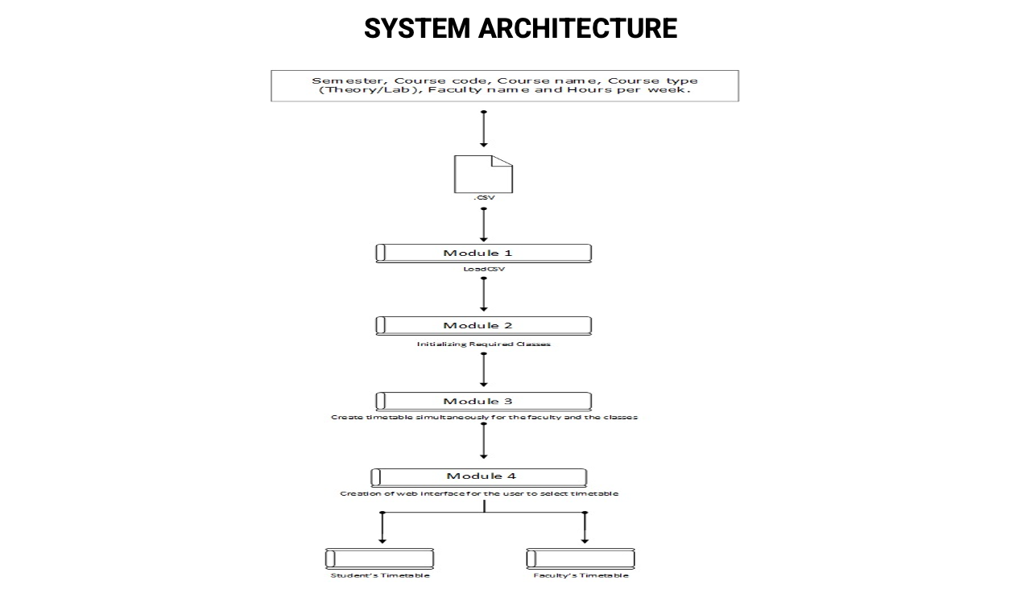

Slide 4
MODULE 1: Initialize the required class
This module is used to create a timetable class which will be used to create objects to hold the timetable for each classroom and for each faculty.
Attributes:
Name: This is used to hold the name of the timetable. Example ‘3a’ corresponds to the name of timetable of 3rd Semester A section.
Days: List which has all the working days in a week.
Filled and slot_filled: Used to check whether a time slot in the timetable is filled or not.
Method:
Create_tt method: This method is used to initialize all the timeslots for every day to false.

Slide 5
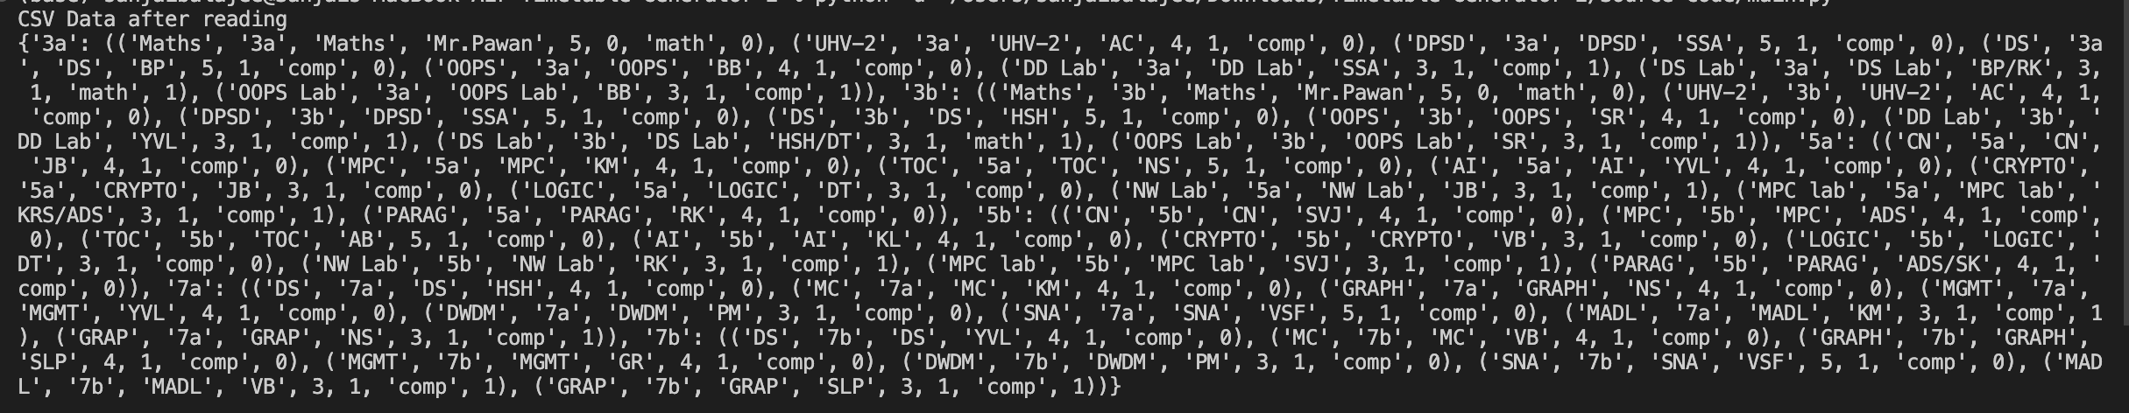
MODULE 2: LoadCSV
Data like Course Name, Course Code, Faculty Name, Semester Details, Hours per week are stored in the form of .CSV file.
This file is read through a csv_reader from the existing csv module in python
Data is grouped semester wise
Grouped data is stored as dictionary of tuples in the variable ‘all_classroom’

Slide 6
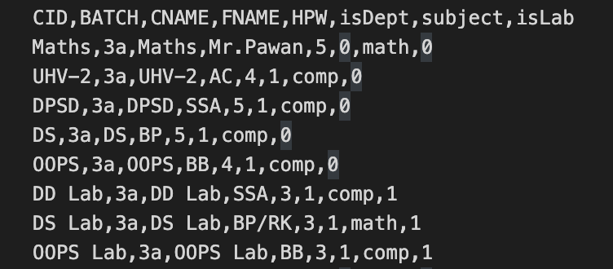
TEST CASE: Sample execution for 3A
INPUT:

Slide 7
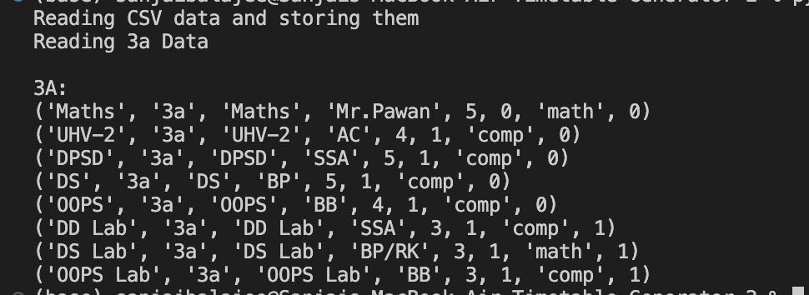
EXECUTION
MODULE 1 and 2:
After the required classes and are created, the required input file is parsed and stored in appropriate data structures.

Slide 8
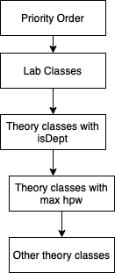
MODULE 3: Creation of TimeTable
While allotting classes, the first priority is given to labs
After labs are allotted, we allot the first hour classes
Then we allot all other theory classes based on Hours
per week
Then we allot free slots to mentor, library, sports and
tutorial.

Slide 9
MODULE 3: Creation of TimeTable
Sub module 1: LAB allotment
Iteration through subject list.
Check for isLab=1.
Set lab days = {,’Monday’,‘Tuesday’,’Wednesday’}.
Set lab timings={1,2,6}.
Choose a day and a timeslot randomly, check if the timeslot is filled or not and if not we allot the Lab.
Remove the course from the subjects list.

Slide 10
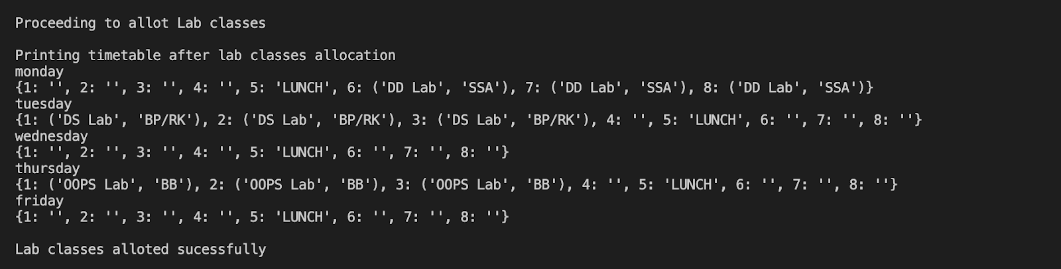
EXECUTION
MODULE 3
We start allotting classes, First priority is given to labs so they are allotted first. We allot Lab on Mondays, Tuesdays and Thursdays in the slots 1,2,6 to avoid Lunch. We randomly choose day and timeslot and allot lab making sure the slot is free

Slide 11
MODULE 3: Creation of TimeTable
Sub module 2: Theory classes allotment (First-Hour)
Modified subject list is iterated.
Checking for isdept=1.
From the permutation of Days=['Monday', 'Tuesday', 'Wednesday', 'Thursday', 'Friday'] and time [1], randomly select a (day, time) pair.
The (day, time) pair is checked for free slots in faculty Timetable and the days are allotted accordingly.
Remove that (day, time) pair from original Days x Time permutation.

Slide 12
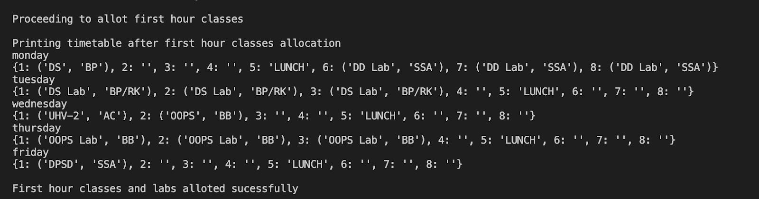
EXECUTION
MODULE 3
The next priority is given to first hour classes. As no other department courses like math should not be allotted in the first hour, We give preference to the courses with isDept=1. Now we allot those courses on any day and in the first hour.

Slide 13
MODULE 3: Creation of TimeTable
Sub module 3: Theory classes allotment (Other days/hours)
The ‘remaining_subjects’ list is iterated till the hours per week reaches 0.
Inside the loop a computer generated random choice of Days = ['Monday', 'Tuesday', 'Wednesday', 'Thursday', 'Friday'] and time =[1,2,3,4,6,7,8] and stored as (day,time) pair.
The pair is checked with the overall permutation of Days x time and if there is free slot in the faculty time table for that (day,time) pair.
A condition to check if (day,time-1) or (day,time+1) has the same course allotted, so that we can avoid consecutive hours (soft constraint).
After checking, the (day,time) pair is fixed for that particular course and removed from the original Days x time combinations.

Slide 14
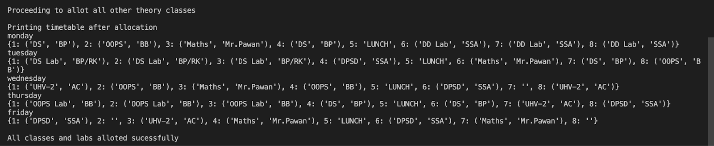
EXECUTION
MODULE 3
Now we allot all other courses on any day and in any free timeslot randomly. We also make sure that the number of that courses on that day is never greater than 2. We fix the slot after allotting the course

Slide 15
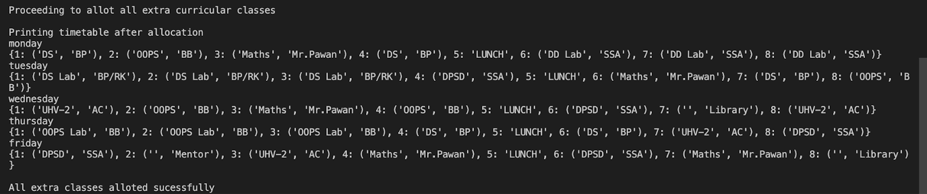
EXECUTION
Now we allot free slots to extra curricular hours like Library, Mentor, Sports and tutorial

Slide 16
MODULE 4: Creation of interface to display the timetable
The generated timetable in module 3 is displayed in a webpage using flask.
The webpages are loaded using the flask module and the main page is loaded via the main_page function. This function renders the “index.html” file and is connected to the buttons and when the buttons are clicked the respective pages are opened
There are two main pages, one to view student timetable and one to view faculty timetable.
The classroom and faculty name and can be chosen from the drop down and appropriate timetable is displayed in tables.

Slide 17
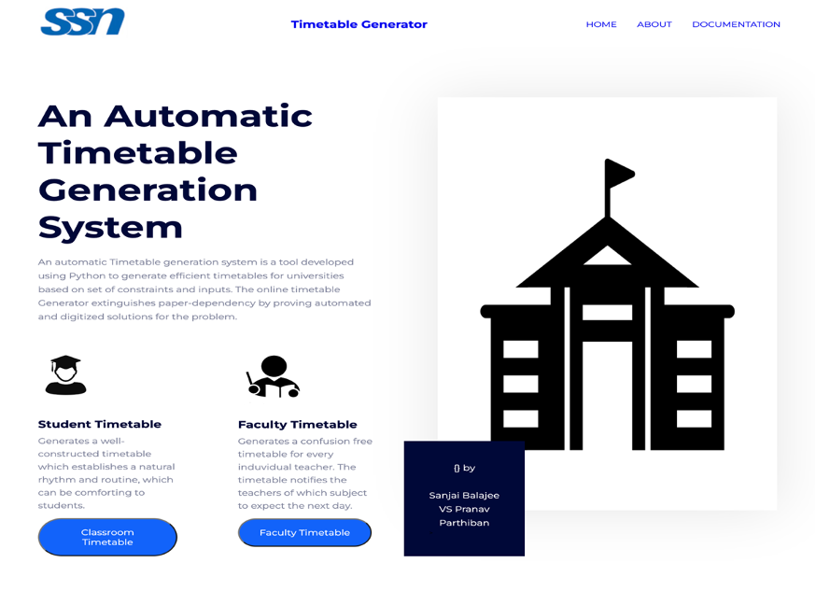
Main Page

Slide 18
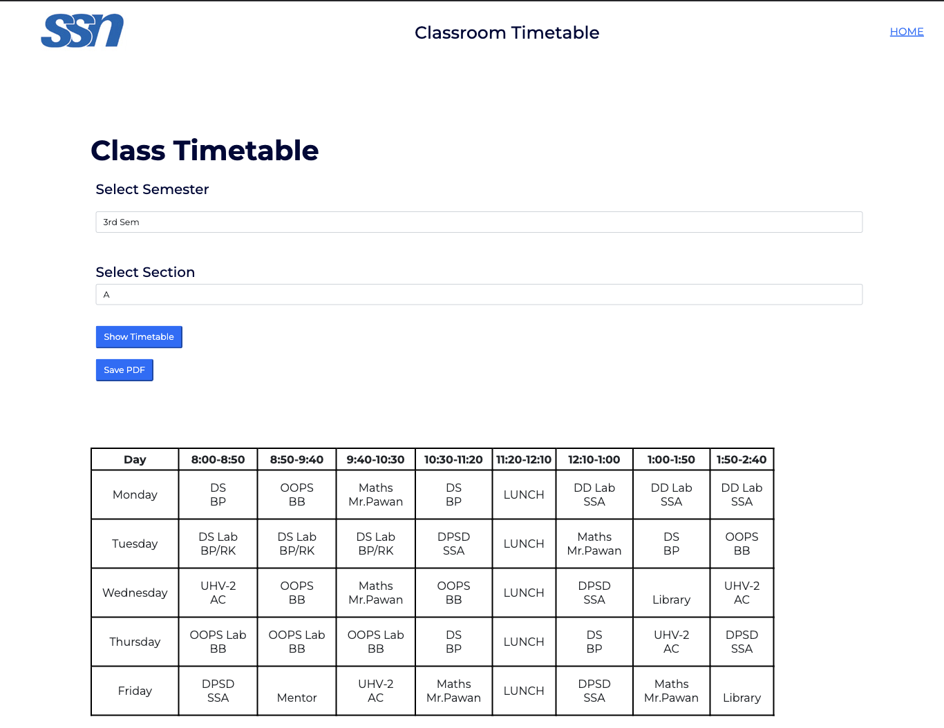
Student Timetable

Slide 19
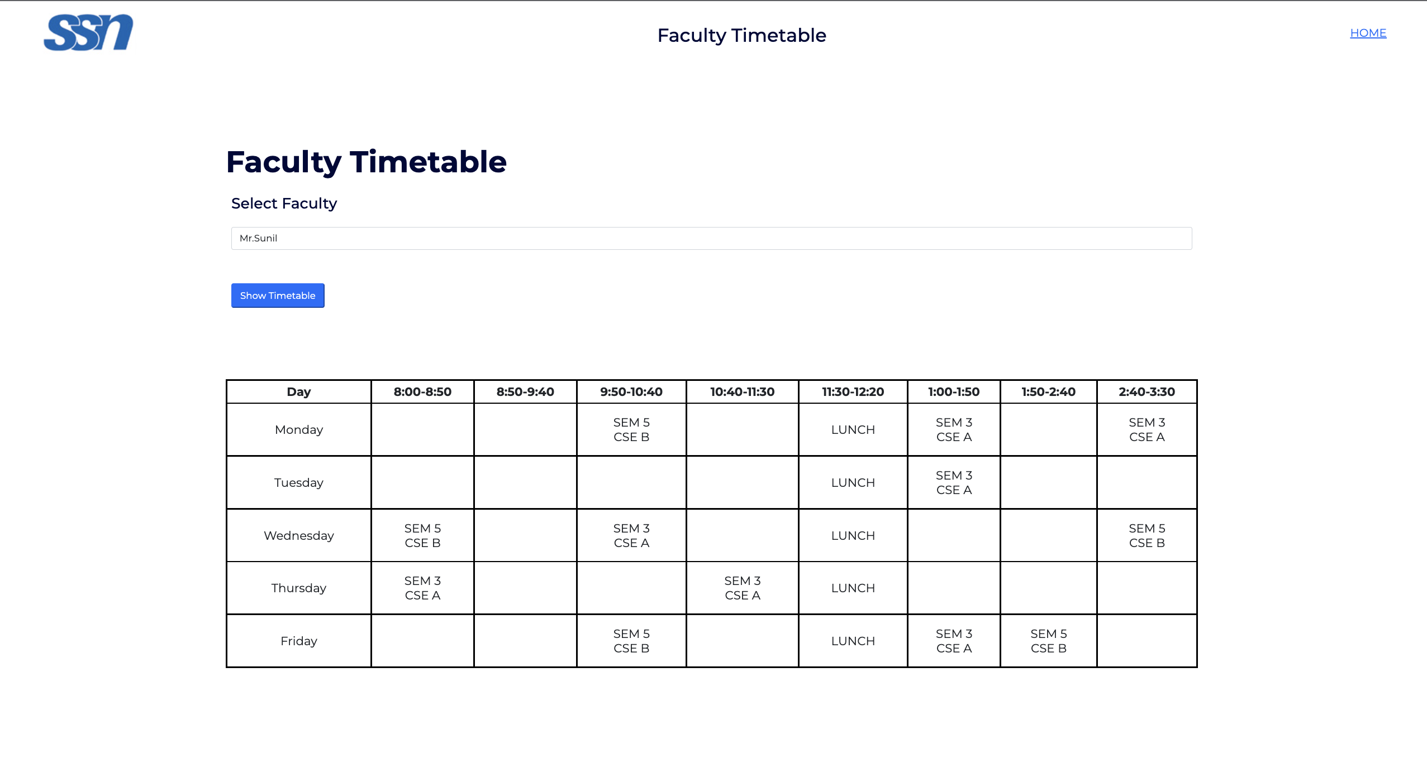
Faculty Timetable

Slide 20
References
Lukas, Samuel & Aribowo, Arnold & Muchri, Milyandreana. (2012). Solving Timetable Problem by Genetic Algorithm and Heuristic Search Case Study: Universitas Pelita Harapan Timetable. 10.1109/ICADIWT.2009.5273979.
https://github.com/btzy/autotimetable
Francis, kussu. 2022. "Scheduling Algorithm For University Timetabling Problem".
Academia.Edu.

